Slide 1

ENVIRONMENTAL MONITORING SYSTEM
Presented by Srishty Sharma​
(ECE-2nd year)

Slide 2
Overview
To develop an environmental monitoring system using Arduino.
This project measures the air quality, temperature, and humidity using sensors.
All the real-time data collected from these sensors gets displayed on the LCD.
There is also an alert system via LED for poor air quality.
Environmental Monitoring System

Slide 3
COMPONENTS LIST
Component | Quantity | Description
Arduino UNO | 1 | Microcontroller board to control the system
16x2 LCD Display | 1 | Displays temperature, humidity, and air quality
Potentiometer (x3) | 3 | Used as analog inputs simulating: temperature, humidity, air quality
Temperature sensor (TEMP36) | 1 | Reads ambient temperature (actual sensor, not simulated)
Resistors (220Ω) | 2 | One for current limiting in LCD & one for LED
Breadboard | 1 | For connecting components without soldering
Jumper Wires | Several | For making connections between components
LED (Red) | 1 | Lights up when air quality is poor (air quality > threshold)
USB Cable | 1 | To power the Arduino and upload code

Slide 4
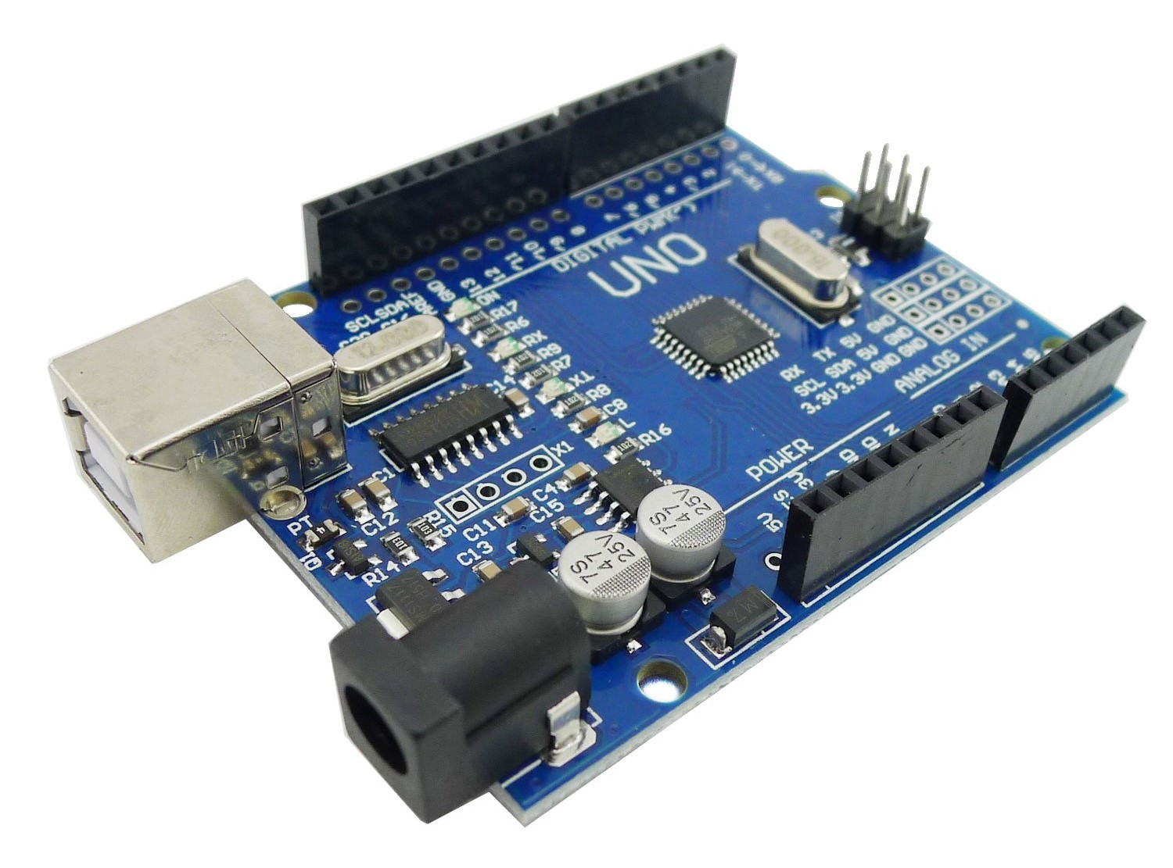
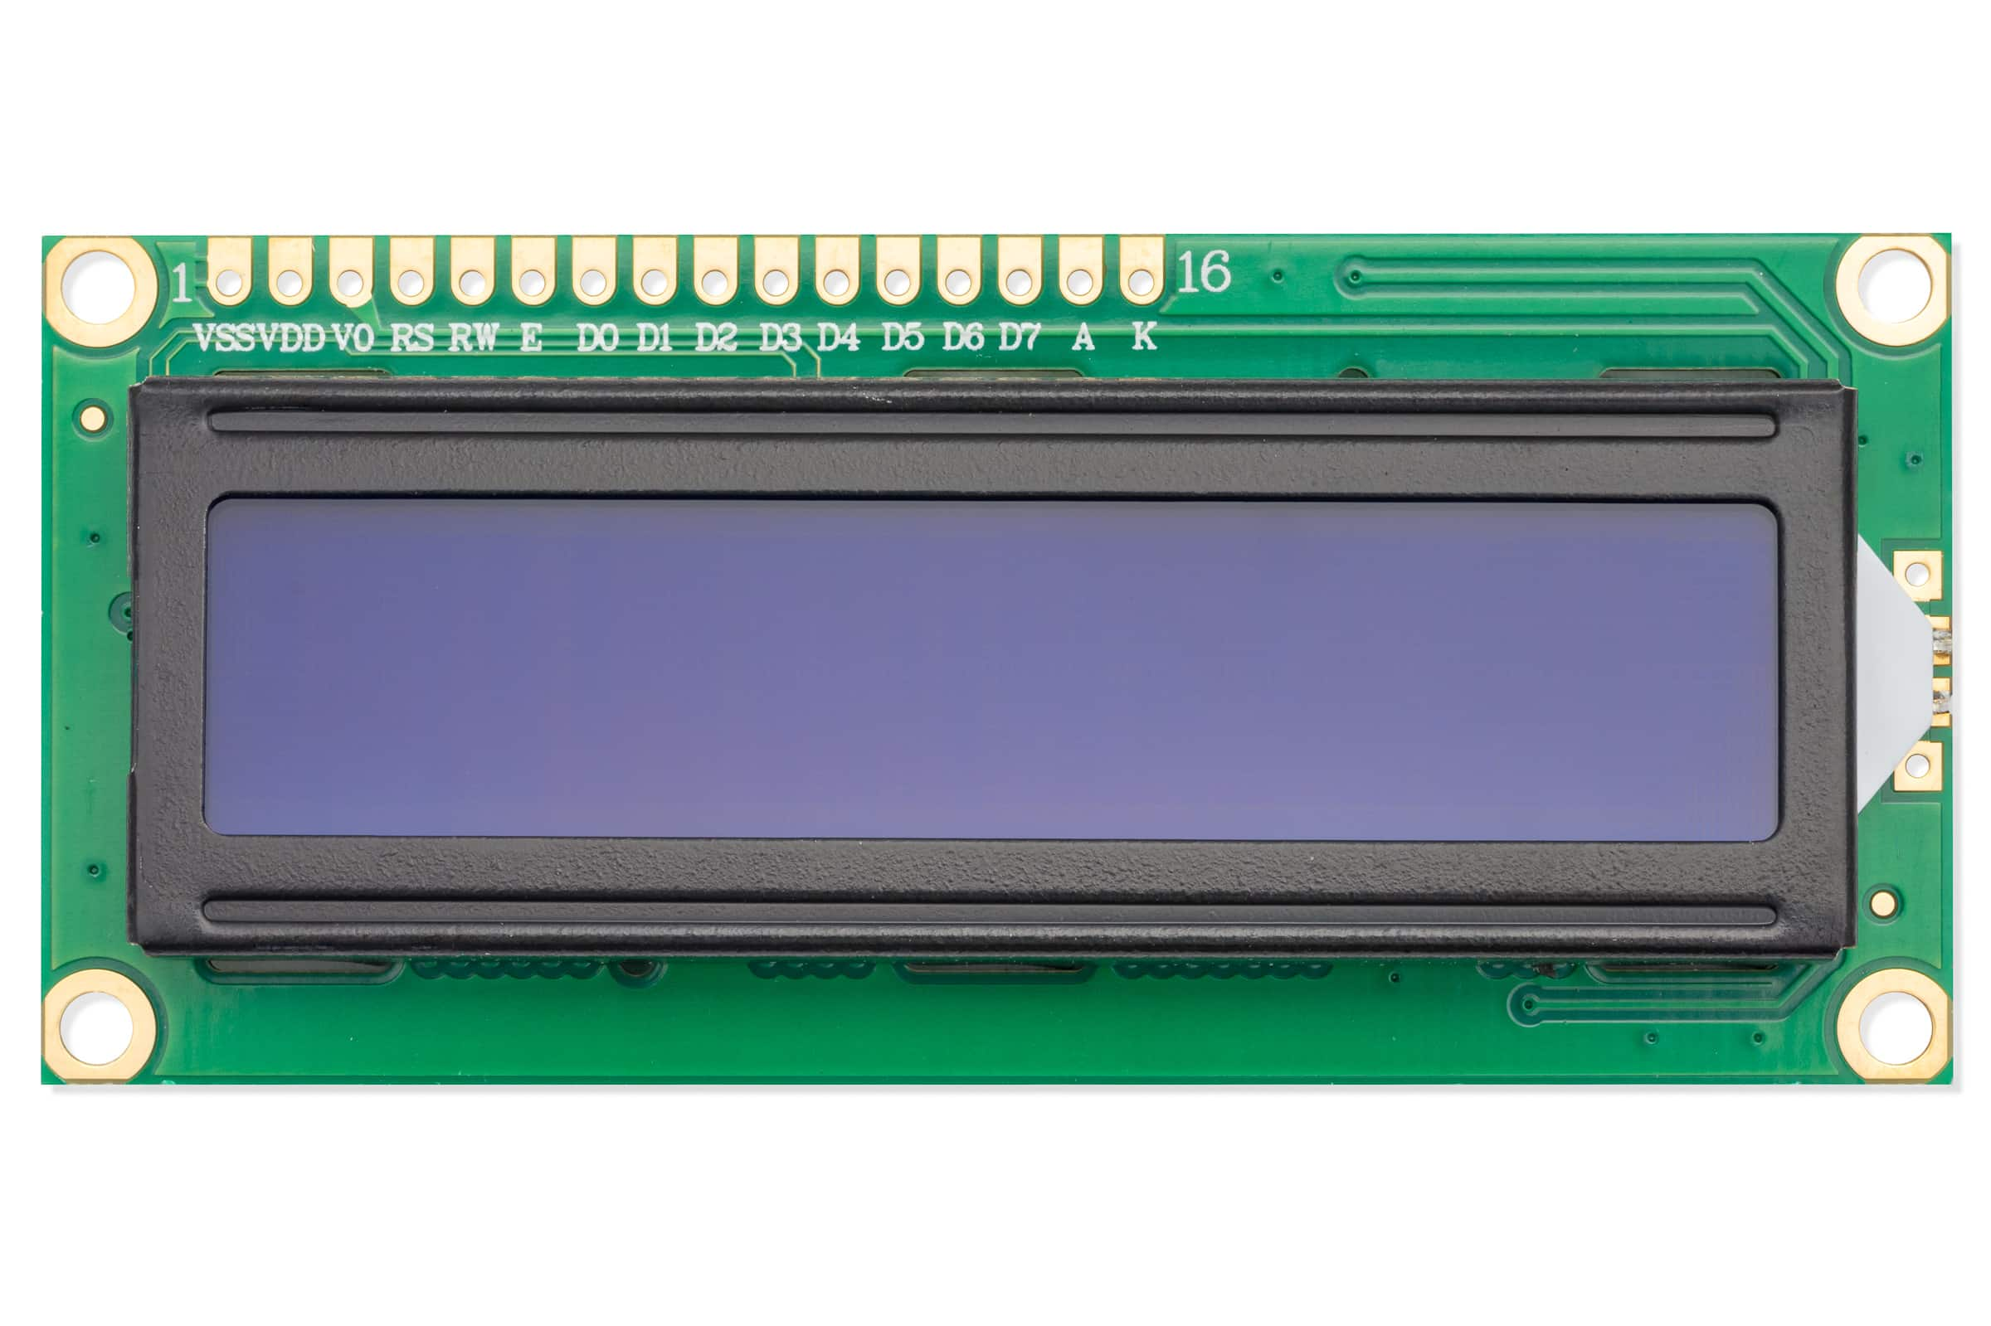
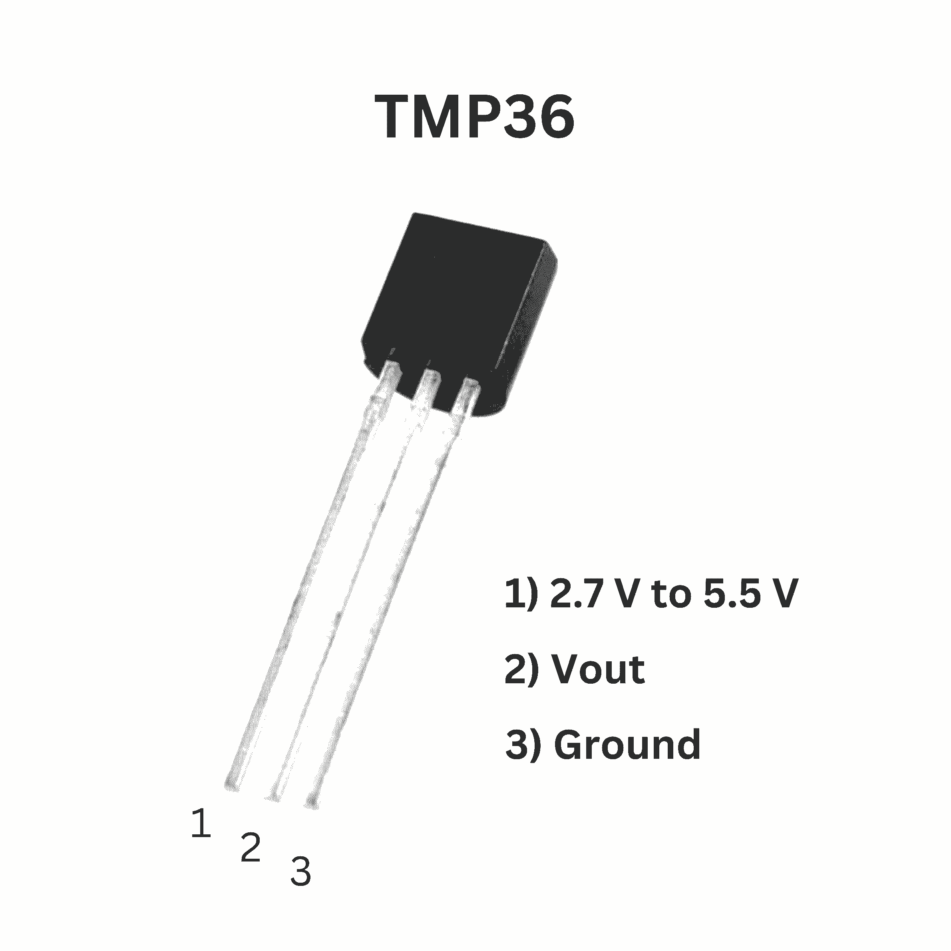
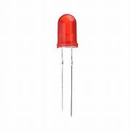
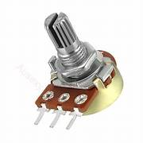
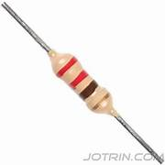
Environmental Monitoring system

Slide 5
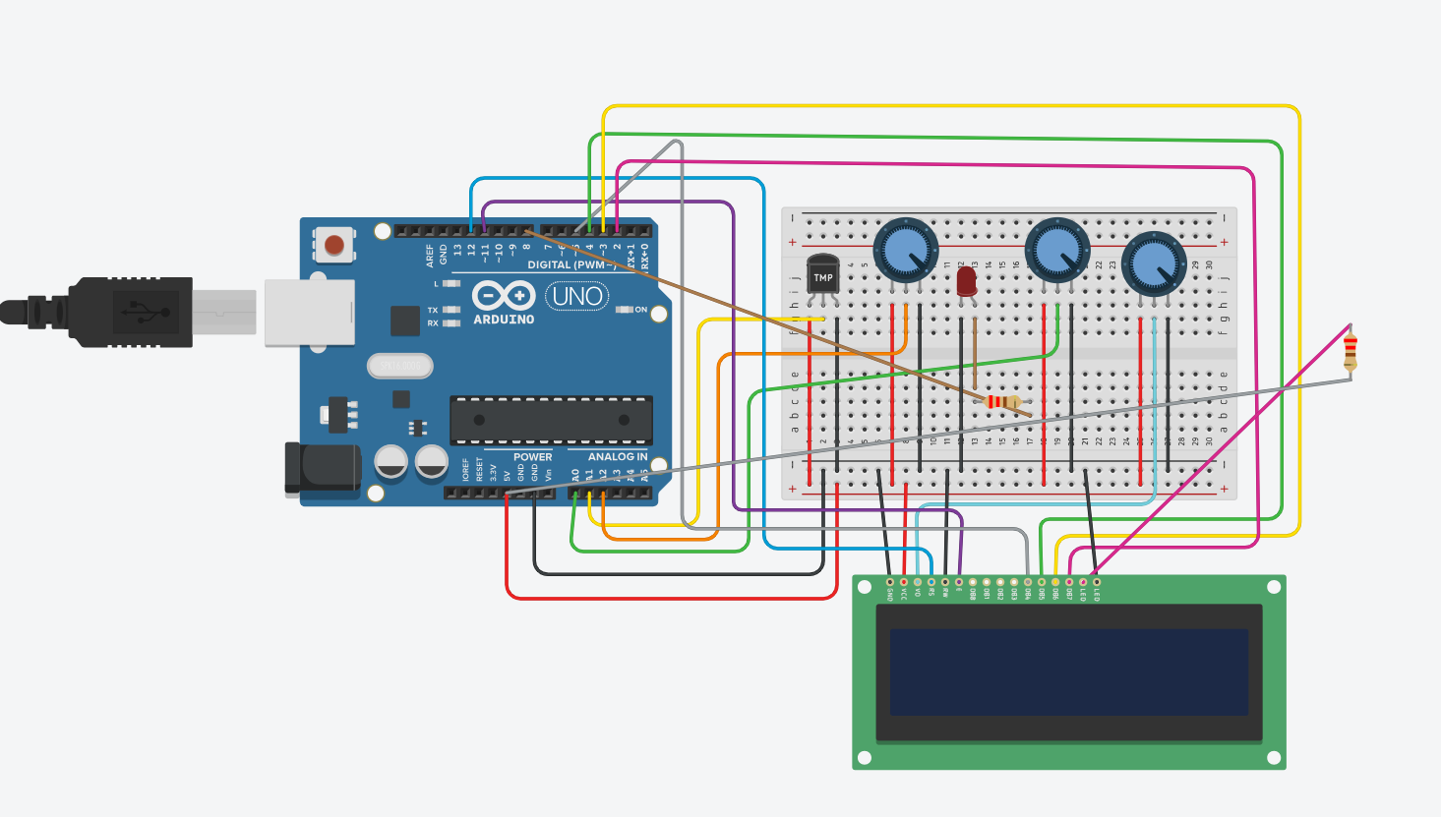
CIRCUIT DIAGRAM

Slide 6
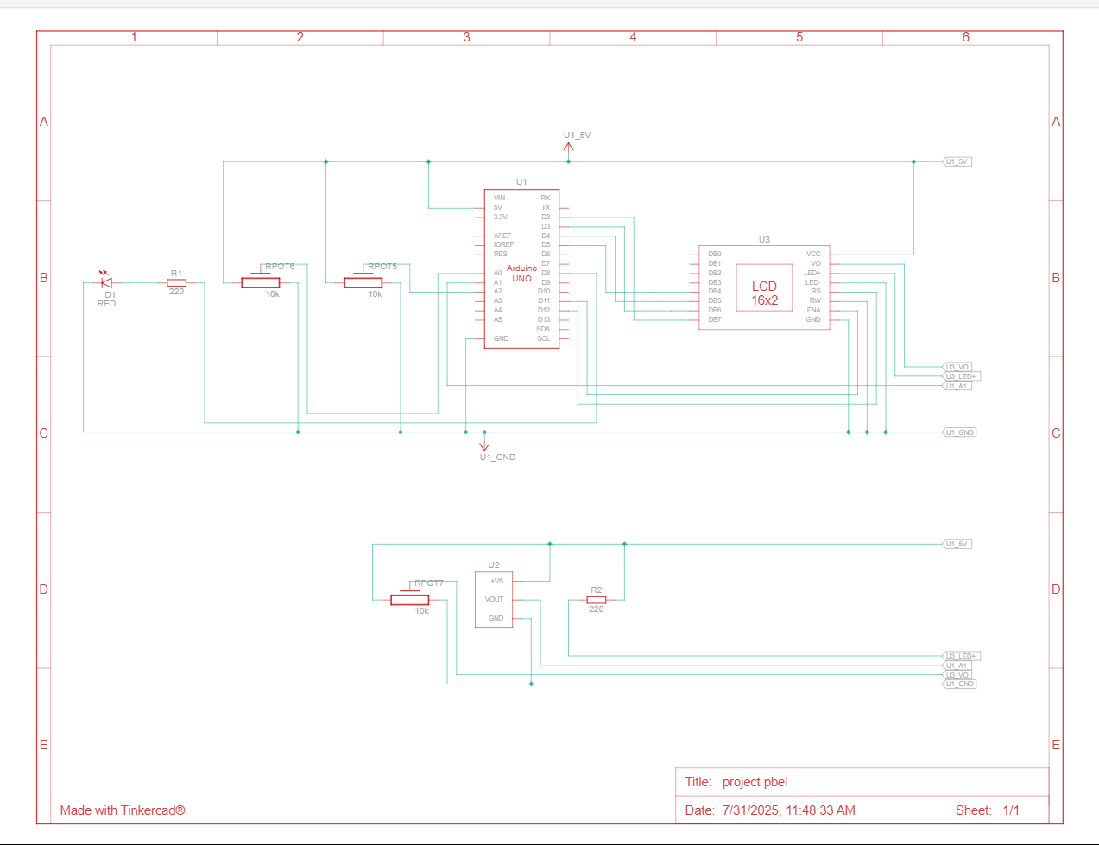
SCHEMATIC VIEM

Slide 7
CODE SNIPPET
LCD & Pin setup
#include <LiquidCrystal.h>
// LCD setup: (RS, E, D4, D5, D6, D7)
LiquidCrystal lcd(12, 11, 5, 4, 3, 2);
// Pin assignments
const int tempPin = A2; // Temperature pot
const int humidityPin = A1; // Humidity pot
const int mq135Pin = A0; // Air quality pot
const int ledPin = 8; // LED pin
Setup function
void setup() {
pinMode(ledPin, OUTPUT);
lcd.begin(16, 2);
lcd.print("Hi");
delay(2000);
Serial.begin(9600);
}
Loop
void loop() {
// Read values from pots
int tempRaw = analogRead(tempPin); // 0–1023
int humidityRaw = analogRead(humidityPin);
int airQuality = analogRead(mq135Pin);
// Map to human-readable values
int temp = map(tempRaw, 0, 1023, 20, 40); // 20–40°C
int humidity = map(humidityRaw, 0, 1023, 30, 90); // 30–90%

Slide 8
ARDUINO CODE OVERVIEW​
Pin Setup
What the Code Does
Final Output​
LCD is connected to 6 digital pins.
Air quality sensor (MQ135) → A0.
Temperature sensor (LM35) → A1.
LED → Digital pin 8.
Potentiometer → controls LCD brightness
Reads temperature from the sensor.
Reads air quality from MQ135.
Shows both values on the LCD.
Turns on LED if the air quality is bad
Temperature + air quality on the LCD.
LED turns ON when pollution is detected.
The library used is LiquidCrystal to control the LCD screen

Slide 9
WORKING PRINCIPLE
The potentiometers simulate the real sensors
LCD displays these values line by line
Values also printed in Serial Monitor
The values are mapped to temp(20-40°C),humidity(30-90%)
If air quality > 300 then LED turns ON

Slide 10
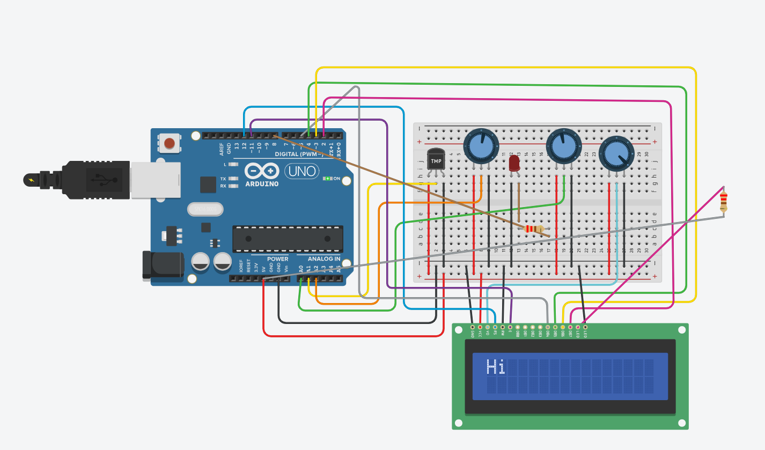
OUTPUT:AFTER SIMULATION

Slide 11
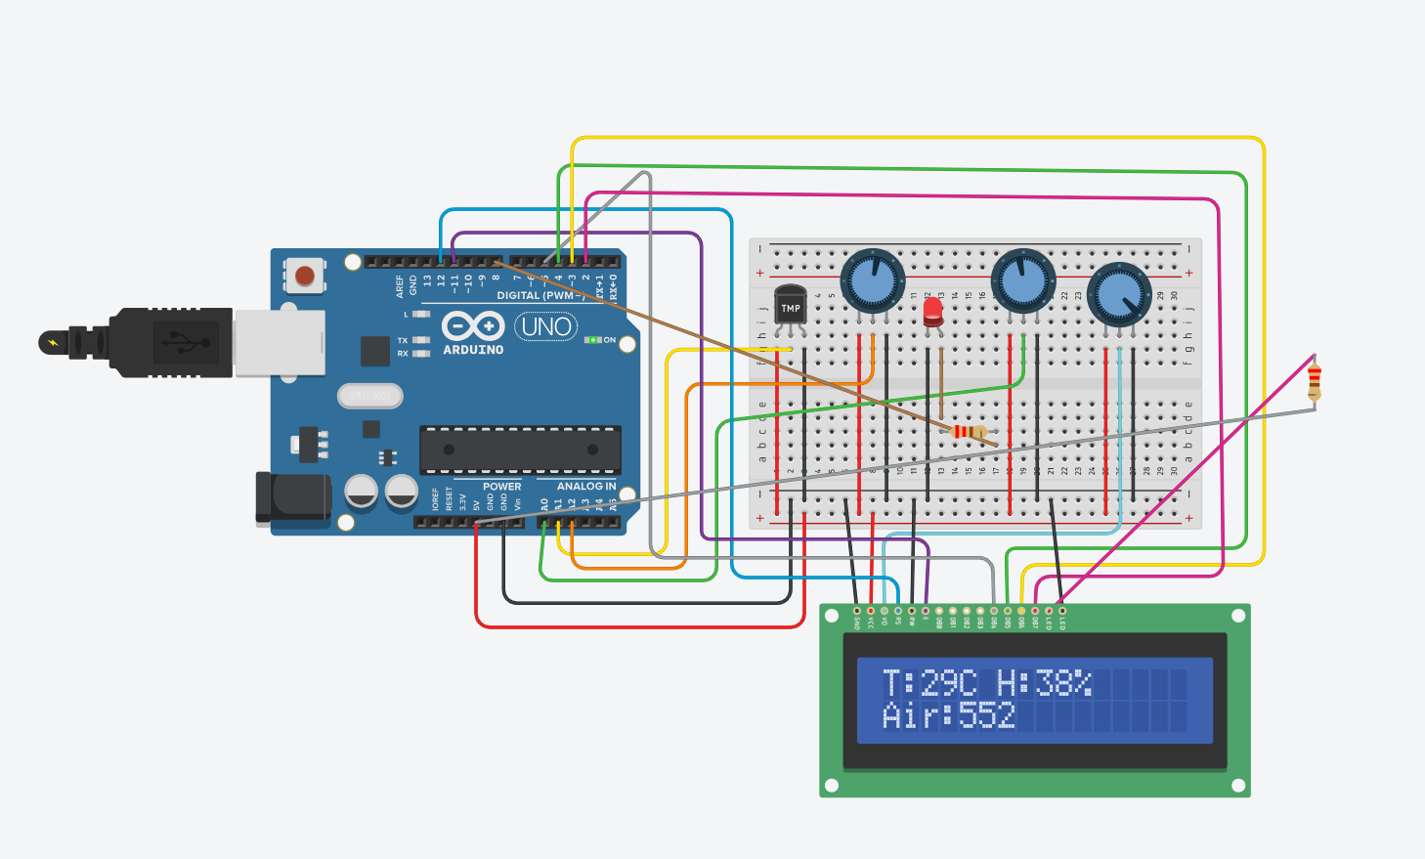
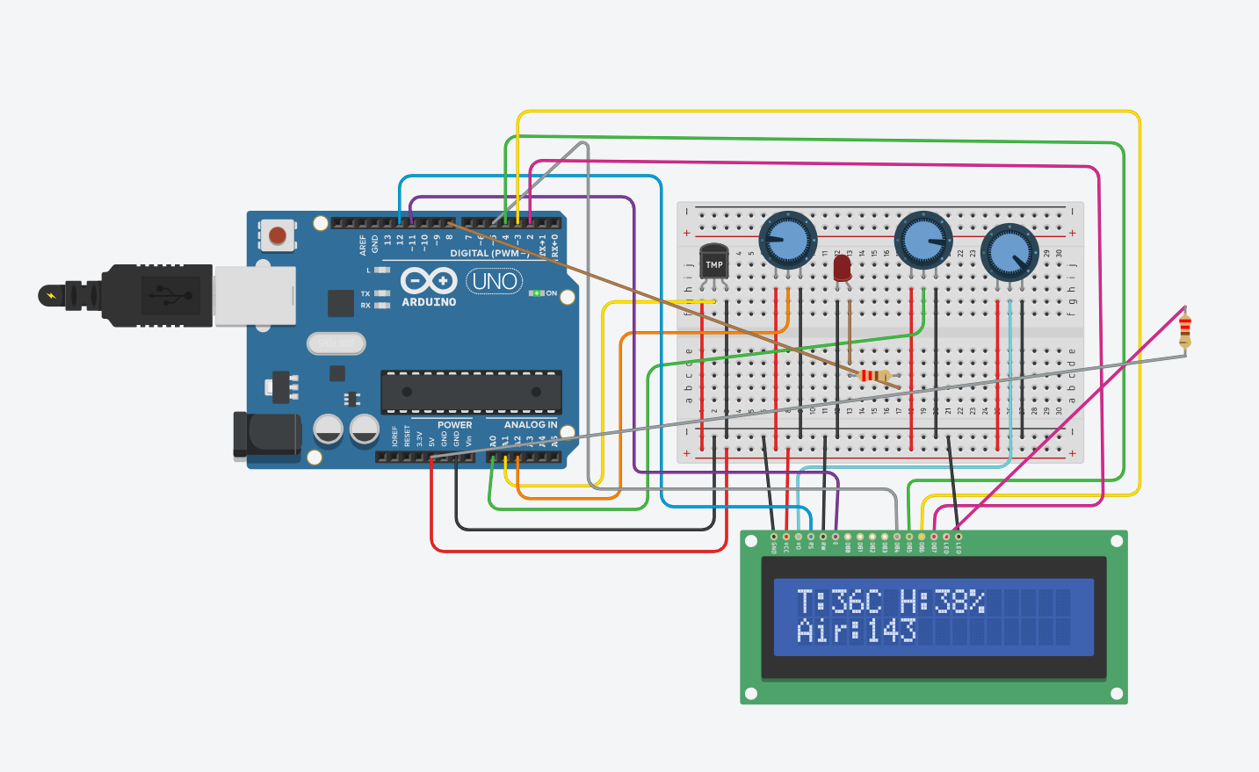
AFTER SIMULATION
When air > 300
When air < 300

Slide 12




Applications
Indoor air quality monitors
Smart ventilation or AC systems
Basic health environment alert systems
Educational STEM/IoT projects

Slide 13

Limitations & future enhancements
Limitations
Future enhancements
Uses potentiometers instead od actual sensors.
No internet connectivity or mobile alerts.
Only local display (no data logging).
Replace potentiometers with DTH11(Temp + Humidity) and MQ135(Air quality).
Add Wi-Fi module(ESP8266) for remote monitoring.
Include buzzer or mobile alert.
Solar-powered version for eco-friendliness.

Slide 14
conclusion
This project proves how simple electronics and coding can create powerful real-world solutions. It lays the foundation for more advanced environmental systems, promoting awareness and sustainability through technology.

Slide 15

Thank you

